Slide 1


Git Ignore

Slide 2

Agenda
What is .gitignore
Where to use it
How to ignore files and folders, common patterns.
Debugging

Slide 3
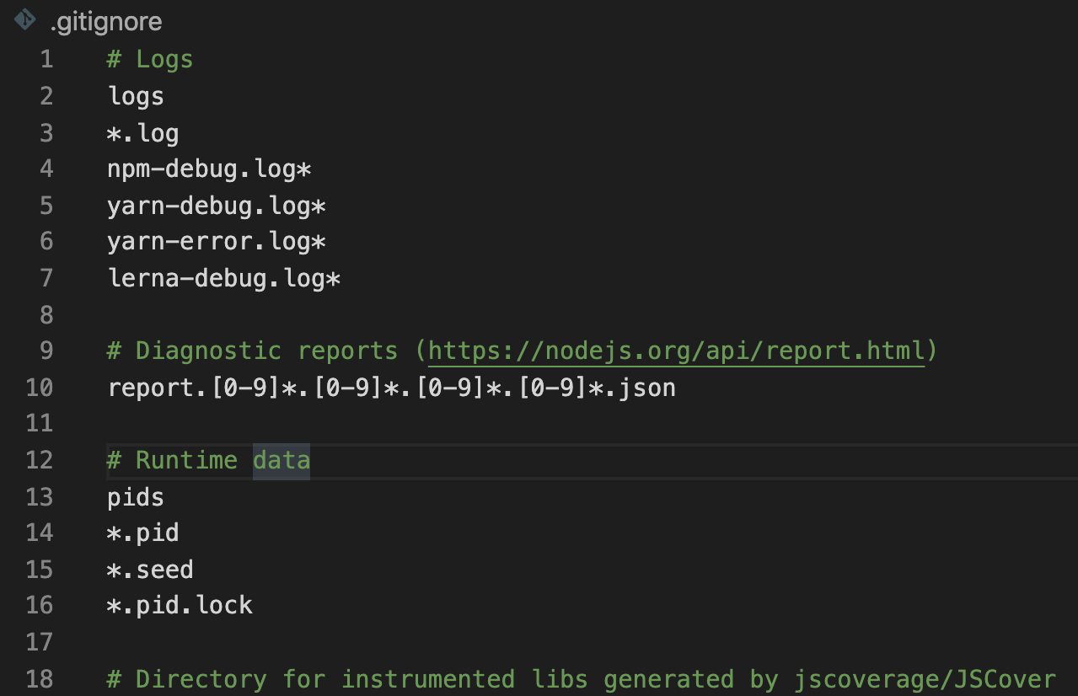
How it Works
A .gitignore file is a plain text file where each line contains a pattern for files/directories to ignore.
This is how a gitignore file might look like:
Where each line is a folder/file to ignore.
The # indicates it is a comment
There are some special characters/combinations to perform special selection of files and folders.

Slide 4
GIT: gitignore
.gitignore is a file that Git uses to ignore files that you don’t want to commit (or track changes)
From git documentation:
“A gitignore file specifies intentionally untracked files that Git should ignore. Files already tracked by Git are not affected”
Untracked === Git is not going to check the differences that this file has (created, modificated, deleted), thus not adding its changes to the staged area, and in consequence, not going to commit those changes.

Slide 5
Introduction to the problem
When you make commits in a git repository, you choose which files to stage and commit by using git add FILENAME and then git commit.
git add <some_file_name>
git commit -m “<some_useful_message>”
But what if there are some files that you never want to commit? It's too easy to accidentally commit them (especially if you use git add . to stage all files in the current directory).
That's where a .gitignore file comes in handy!
It lets Git know that it should ignore certain files and not track them.

Slide 6
What to ignore?
Dependencies that can be downloaded from Package Managers / local environments / system files:
node_modules folder in NodeJS projects
ENV folder in Python Projects
.DS_Stores folder in MAC OS computers
Generated files like dist folders
Files that contain API keys/secrets, credentials, or sensitive information and you don’t want them to be shared publicly:
Connections to databases like MongoDB
.ENV files
Extensions not related to the project (.pdf, .zip)
Log files

Slide 7
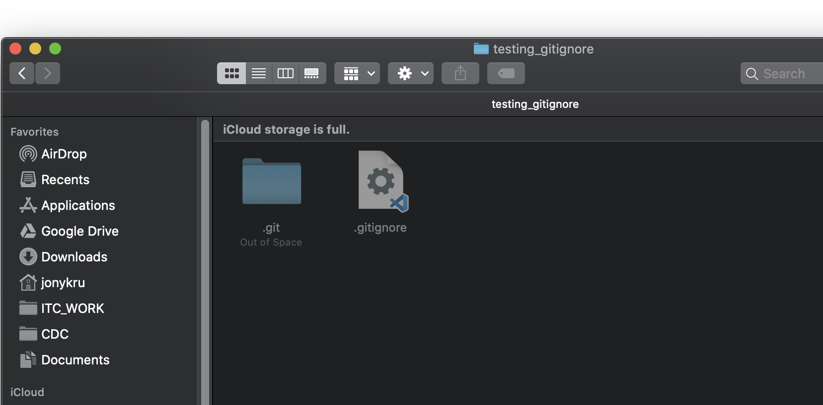
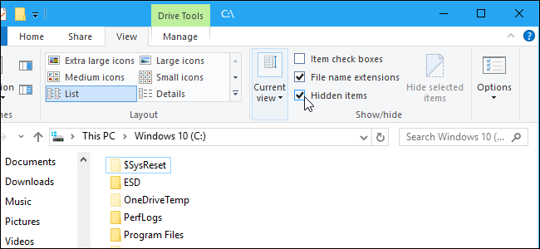
Before we start: show hidden files
Beware that the .gitignore itself it is a hidden file. So you would need to turn on the visibility of hidden files in your OS:
For MAC:
⌘ + ⇧ + .
For Windows:
Check the checkbox of Show Hidden files

Slide 8
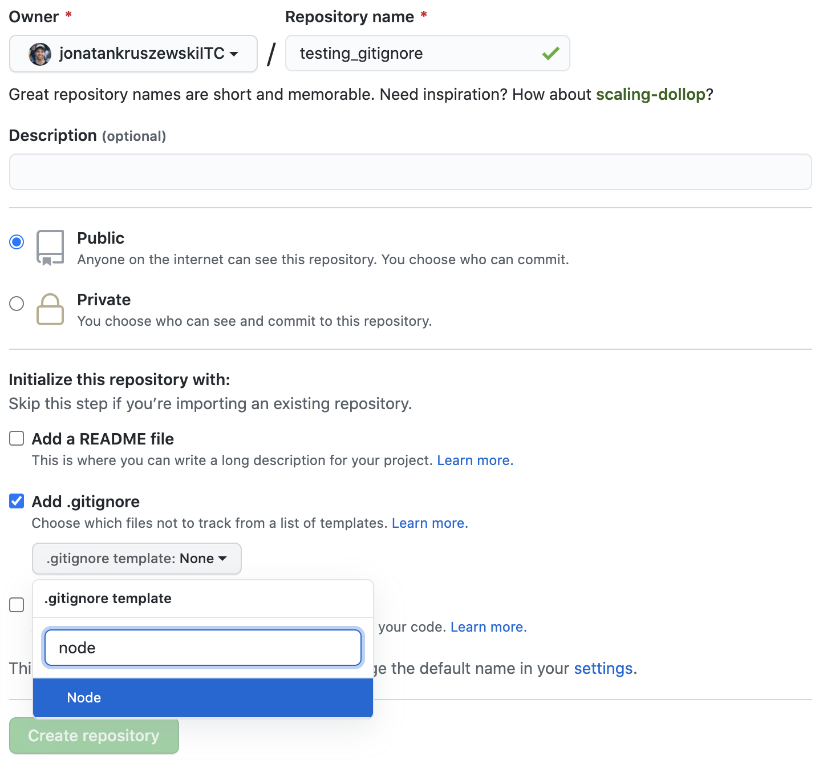
Using gitignore templates
When you create a new Repository, you have the option to create and commit a .gitignore file with anyone of github’s templates:
Python
NodeJS
Many Many more
Beware, that it will create a commit for it!
So, if you have already started working locally:
You will have to solve conflicts when pulling if you still haven’t committed.
Or allow to combine histories by using:
pull --allow-unrelated-histories

Slide 9

Using gitignore templates
You can get an idea for what sort of files to ignore on gitignore.io, by selecting your operating system, text editor or IDE, languages, and frameworks.

Slide 10
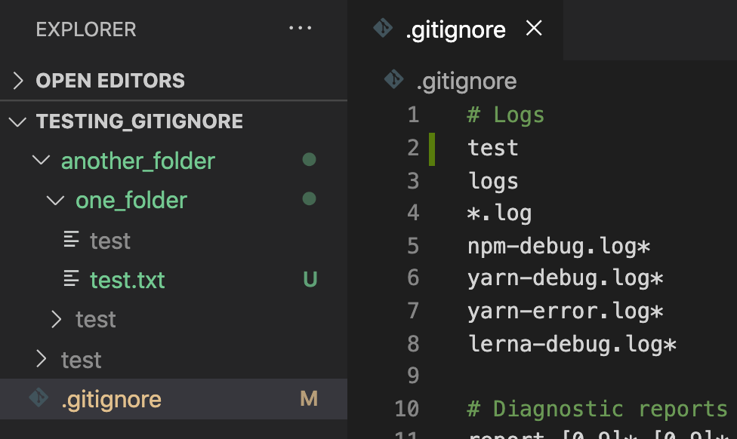
Patterns
Literal File Names:
The easiest pattern is a literal file name/folder, for example:
test
Will ignore any file or folder with that name.
Have a look at the following:
Gitignored files are grayed out in VSC.
The folder ./another_folder/test got gitignored.
Also the file named test (without extension)
Test.txt doesn’t get ignore because its extension.

Slide 11
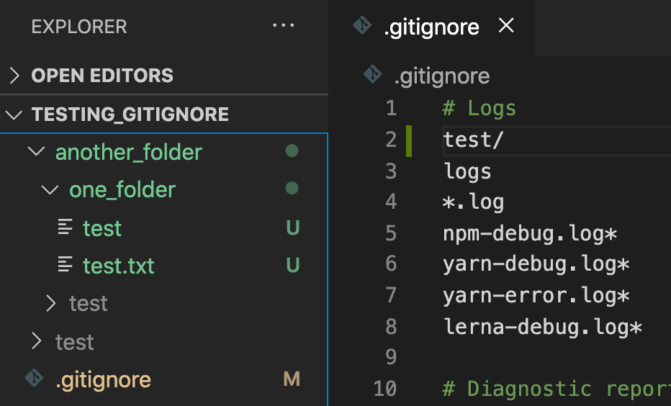
Patterns
Folders:
To specify that it is a folder, add the / :
test/
Will ignore only folders with that name.
Have a look at the following:
The test file (without extension) is not ignored any more.

Slide 12
Patterns
Wildcard:
The * matches 0 or more characters (except the /). So, for example, *.log matches any file ending with the .log extension.
*.log
Have a look at the following:
The test file (without extension) is not ignored any more.

Slide 13
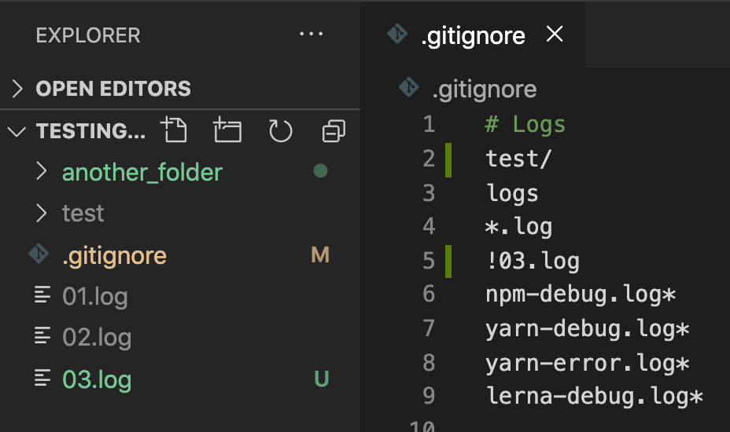
Patterns
Negation
You can use a prefix of ! to negate a file that would be ignored.
!03.log
In this example, 03.log is not ignored, even though all other files ending with .log are ignored.
But be aware, you can't negate a file inside of an ignored directory:
!logs/example.log
Due to performance reasons, git will still ignore logs/example.log here because the entire logs directory is ignored.

Slide 14
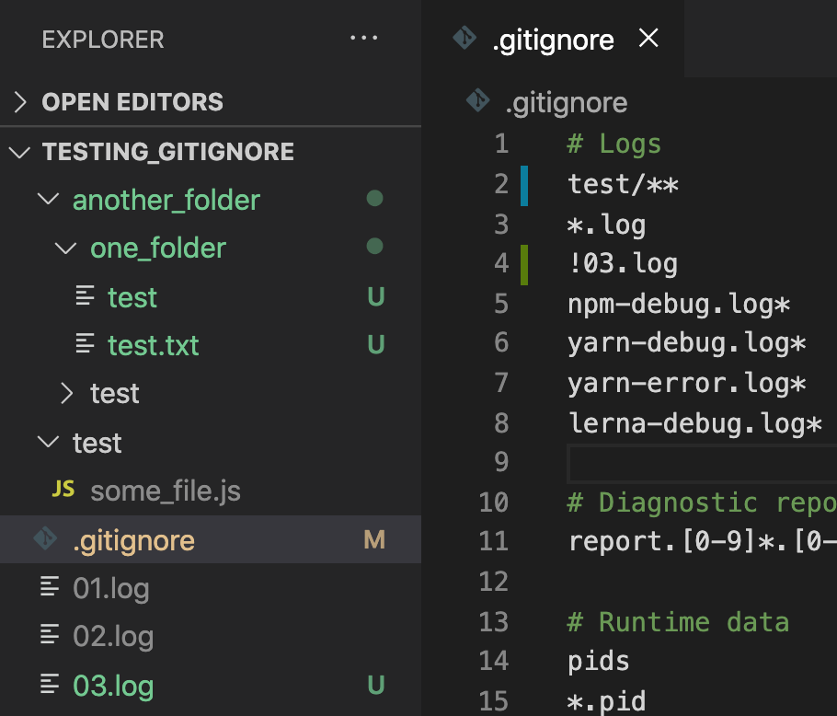
Introduction
Double Asterisk
It means ‘match everything’
test/**
In this case, it means all the files inside the folder test.
Pay attention, that since we are being more specific, the test file and the nested ‘test’ folder inside one_folder are not ignored anymore.
It comes handy to use in the middle of paths
logs/**/*.log
matches all files ending with .log in the logs directory and any of its subdirectories

Slide 15
Fixing gitignore on committed files
What happens if you want to gitignore a file that it was previously committed?
Git will not ignore the file if you've already committed it. You'll have to untrack the file first, then it will start ignoring it.
You will be able to ignore it locally, but you might see it in the remote if you have already pushed it.
To fix that, you need to remove the file / folder from the cache. You can untrack the file with this command:
git rm --cached <FILENAME or FOLDER_NAME>
Then keep as usual: git add, git commit.

Slide 16

Debugging
If you’re having trouble, you can find out why certain files are being ignored by using the git check-ignore command with the verbose option.
git check-ignore -v 02.log
The output will look something like this:
On the right, the pattern that matched it, and on the left, the file.

